Slide 1
Enhancing Low-Light Images Using Retinex Theory: An Approach to Initial Illumination Map Estimation through Local Variance Analysis
Presenter: Mohammed Saidul Islam, 220232724
Course: EECS 6154 [Project]

Slide 2
Content
Retinex Theory
Retinex Theory based low-light image enhancement process
Methods of decomposing an Image to Illumination and Reflectance components in literature
Proposed Approach
Neighborhood based processing
Neighborhood variance calculation
Illumination component construction
Estimation of reflectance
Results
Next Steps
Final Results

Slide 3



Retinex Theory
The Retinex theory [1, 2] denotes that any observed image, denoted as , can be represented as a pixel-by-pixel multiplication of the two components, the reflectance component , and the illumination component . This is depicted as:
Here, encapsulates the scene's inherent attributes, including details and the color characteristics of the original scene, whereas corresponds to the light's intensity and its spatial distribution within the scene's environment.

Slide 4



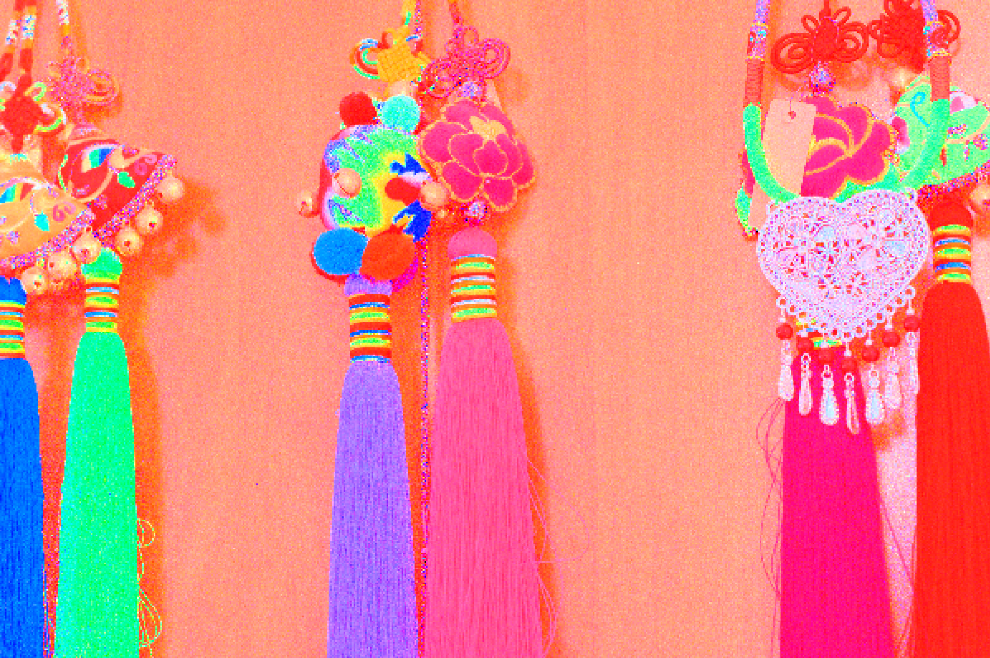
Retinex Theory based low-light image enhancement process
Initial Illumination Estimation
Further processing with methods (i.e., HE, CLAHE, Tikhonov Regularization, Graph based processing etc.)
Input Low light image
Final version
Further processing with methods (i.e., TV, Gamma correction, Graph based processing etc.)
Initial Reflectance Estimation

Slide 5
This project’s focus..
Initial Illumination Estimation
Further processing with methods (i.e., HE, CLAHE, Tikhonov Regularization, Graph based processing etc.)
Input Low light image
Final version
Further processing with methods (i.e., TV, Gamma correction, Graph based processing etc.)
Initial Reflectance Estimation

Slide 6
Methods of decomposing an Image to initial Illumination and Reflectance components in literature
Initial Illumination component estimation:
To initialize the illumination component, [2, 3] computes the mean value of all the pixel across the R, G, B channel (applies meanRGB operator), assuming that for color images, three channels share the same illumination map
On the other hand, [4] computes the max value of all the pixels across the R, G, B channel (applies maxRGB operator) to initialize the illumination component assuming that for color images, the illumination is at least the maximal value of three channels at a certain location
While another method adopted by [5] that converts the image into HSV color space and initialize illumination with the blurred V component in the color space
With the advances in Deep Learning techniques, recent works have focused on data driven techniques to decompose the initialize the illumination and reflectance component, however, these techniques rely on datasets which are often synthetic and limited in size

Slide 7
Methods of decomposing an Image to initial Illumination and Reflectance components in literature
Initial Reflectance component estimation:
After computing the initial value of illumination component, most of the studies initialize the reflectance component by dividing the original image pixel by pixel by the illumination component
With the advances in Deep Learning techniques, recent works have focused on data driven techniques to decompose the initialize the illumination and reflectance component, however, these techniques rely on datasets which are often synthetic and limited in size

Slide 8

Proposed Approach to estimate the initial Illumination component
Illumination typically exhibits a smoother overall variation across an image, while reflectance is usually piecewise smooth with sharp discontinuities
Pixel Neighborhood Analysis
With this fact in mind, the proposed approach performs a neighborhood analysis in a image patch and computes the variance of the pixel values within that neighborhood
A low variance indicates a smoother (more indicative to illumination), while high pixel intensity variance indicates sharp changes (more indicative to reflectance)

Slide 9
Proposed Approach to estimate the initial Illumination component
Constructing the Illumination component
Initially, a new image (initialized with zero) to represent the illumination component is created
For each pixel in the original RGB image, an initial neighborhood is defined, and initial variance of that neighborhood is calculated. Then, the corresponding illumination component’s pixel value is set based on the following criteria:
If the variance is below a certain threshold (indicating smoothness), then the max value from all the channels of the image is assigned to that pixel of the illumination component,
If the variance is high, then the neighborhood size is updated to a smaller region and the pixel value is replaced with an average value of the neighborhood (to enforce smoothness and emphasizes the overall illumination)

Slide 10
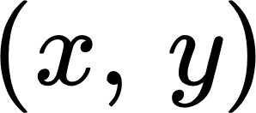
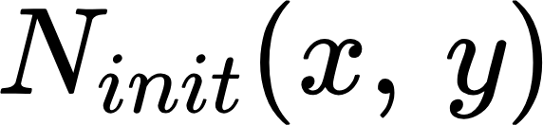
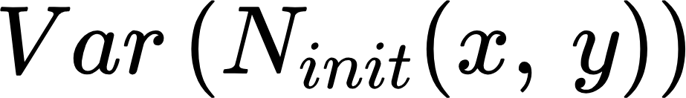
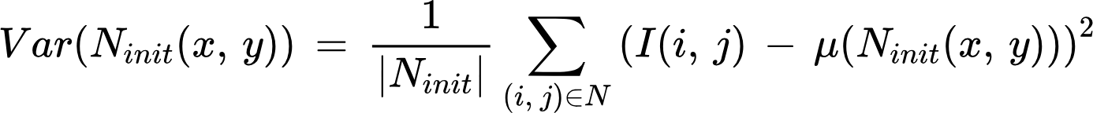

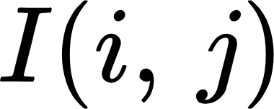
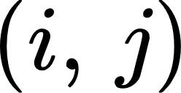

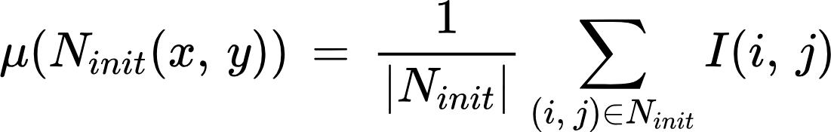
Mathematical formulation of the Approach
Pixel Neighborhood Analysis with Adaptive Neighborhood size
Given an image , for each pixel at location , an initial neighborhood is defined which is a square region of size (neighborhood_size)×(neighborhood_size) centered at
The variance within this neighborhood is calculated as:
where: is the number of pixels in the neighborhood, is the intensity of the pixel at
is the mean intensity of the pixels in the neighborhood, calculated as:

Slide 11
Mathematical formulation of the Approach
Pixel Neighborhood Analysis with Adaptive Neighborhood size
Next, based on the result of initial variance calculation, a new neighborhood size is selected based on the following criteria,
If is greater than variance_threshold, then a small neighborhood size (3x3) is selected
The small neighborhood size indicates the presence of piecewise smoothness with sharp discontinuities

Slide 12
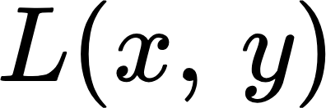
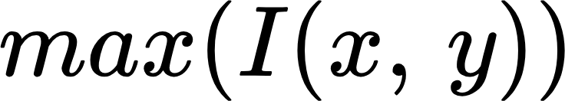

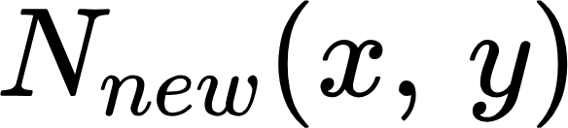
Mathematical formulation of the Approach
Constructing the Illumination component
Finally, for each pixel at , we compare the neighborhood_size,
If neighborhood_size > small_neighborhood_size, the pixel is assumed to be part of a smoothly varying region (illumination), and its value in the illumination component is set to the maximum of the intensity value across three channels [with the assumption that the illumination is at least the maximal value of three channels at a certain location]
If neighborhood_size == small_neighborhood_size, the pixel is in a region with significant variation (more likely reflectance), and its value in is set to the average intensity of its neighborhood, which is calculated as .
where is the newly selected neighborhood size.
​

Slide 13
Mathematical formulation of the Approach
Constructing the Reflectance component
For each pixel at , the reflectance component is constructed as,
​

Slide 14


Results
Illumination component at different variance threshold
Var = 50
Var = 150
Var = 300

Slide 15
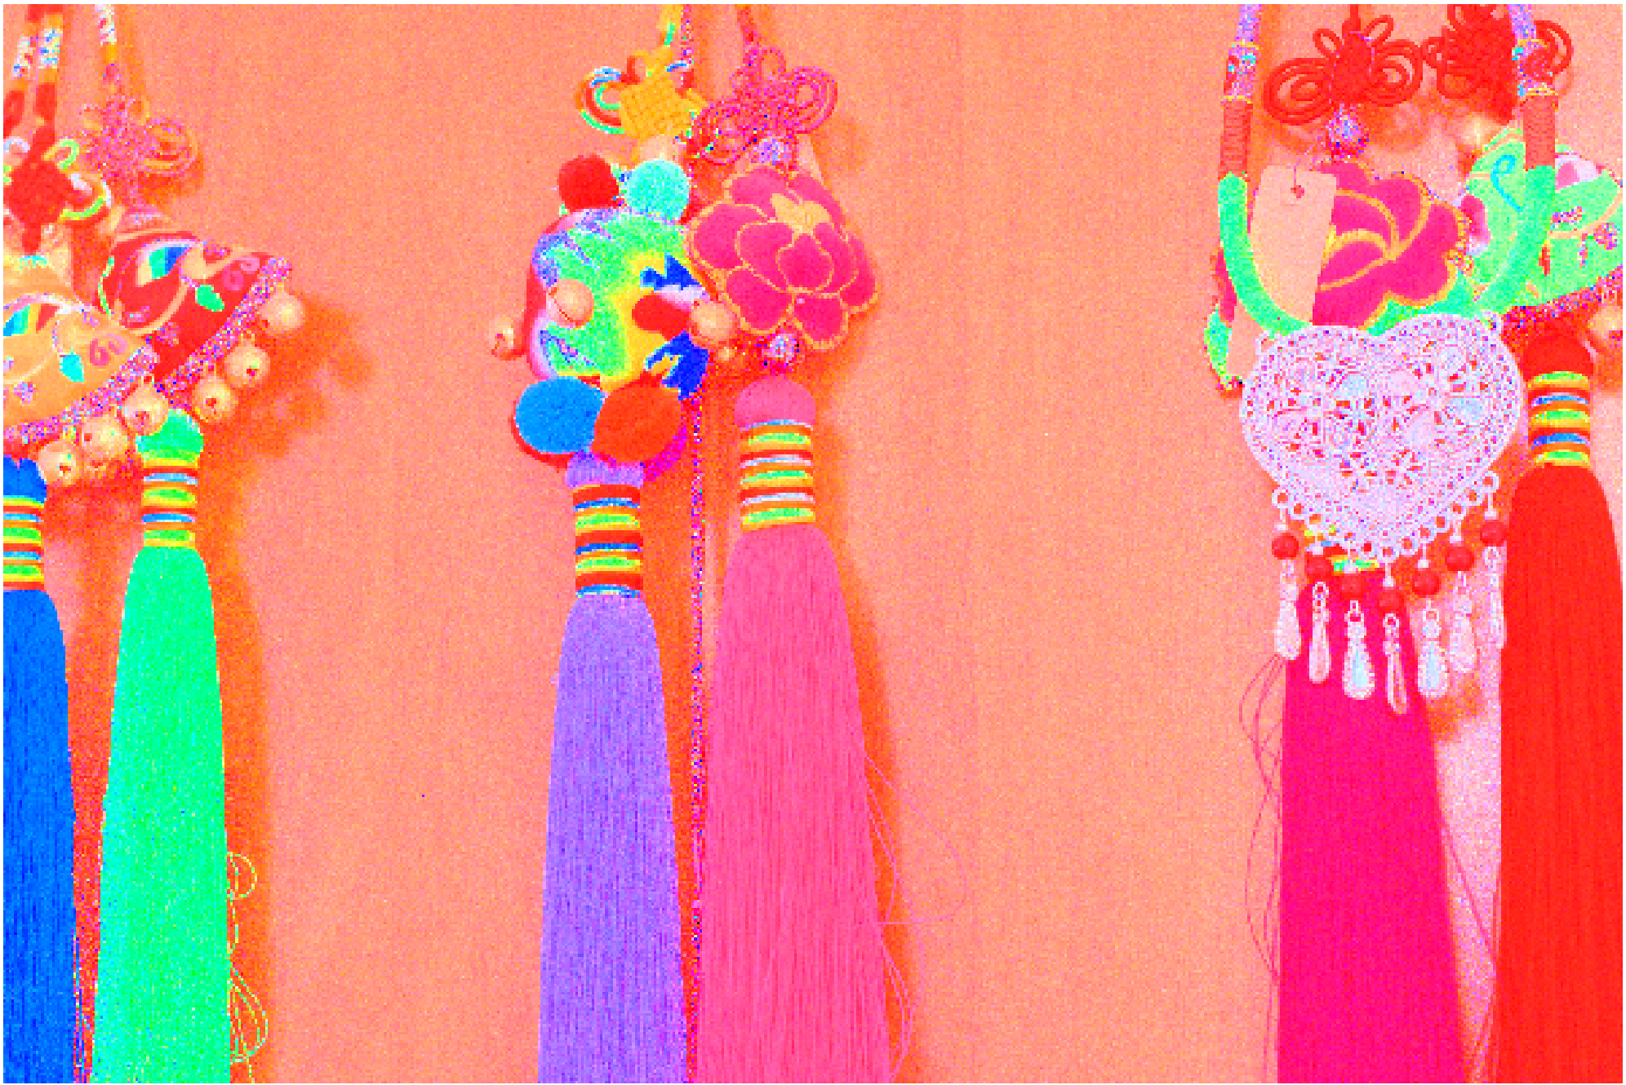
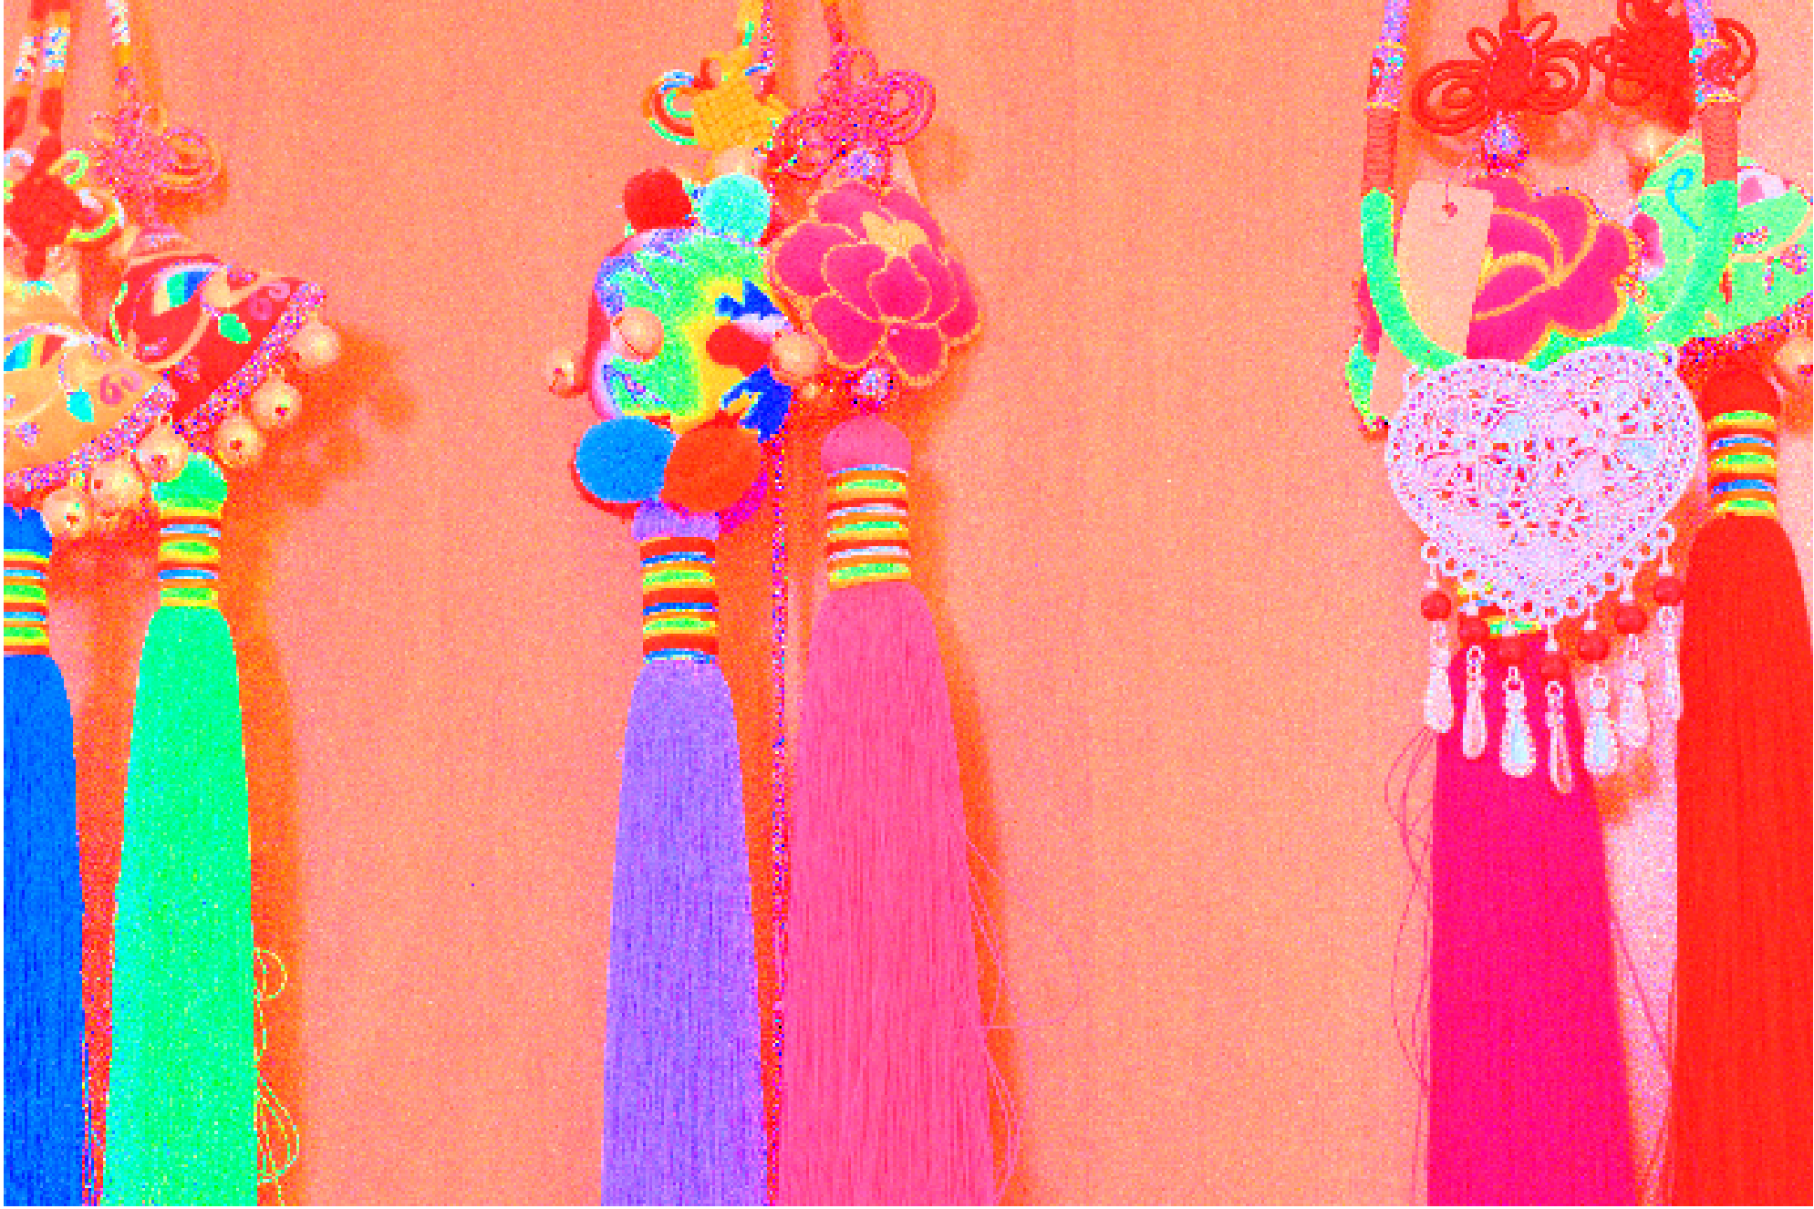
Results
Reflectance component at different variance threshold
Var = 50
Var = 150
Var = 300

Slide 16



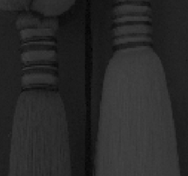
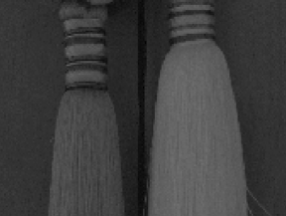
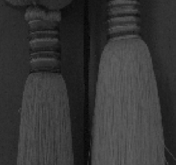
Results
Comparison of Illumination component between other methods
Neighborhood variance method
(more smooth than others)
maxRGB
meanRGB

Slide 17






Results
Comparison of Reflectance component between other methods
Neighborhood variance method
(less noisy while preserving the details)
maxRGB
mean RGB

Slide 18
Next Steps
Improve the Illumination component with Tikhonov regularization
Improve the Reflectance component with Total Variation
Enhance the contrast via CLAHE (Contrast Limited Adaptive Histogram Equalization)
​

Slide 19
Next Steps
​

Slide 20

Final Results
Original Low light Image
After enhanced contrast (without adaptive neighborhood processing)
After enhanced contrast (with adaptive neighborhood processing)

Slide 21


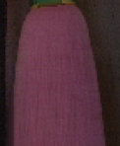
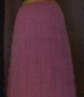
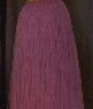
Final Results
After enhanced contrast (with adaptive neighborhood processing)
maxRGB
meanRGB

Slide 22
References
E. H. Land and J. J. McCann, “Lightness and Retinex theory,” J. Opt. Soc. Amer., vol. 61, no. 1, pp. 1–11, 1971.
T. Wu, W. Wu, Y. Yang, F. -L. Fan and T. Zeng, "Retinex Image Enhancement Based on Sequential Decomposition With a Plug-and-Play Framework," in IEEE Transactions on Neural Networks and Learning Systems, doi: 10.1109/TNNLS.2023.3280037.
X. Ren, W. Yang, W. -H. Cheng and J. Liu, "LR3M: Robust Low-Light Enhancement via Low-Rank Regularized Retinex Model," in IEEE Transactions on Image Processing, vol. 29, pp. 5862-5876, 2020, doi: 10.1109/TIP.2020.2984098.
Wei, Chen, Wenjing Wang, Wenhan Yang, and Jiaying Liu. "Deep retinex decomposition for low-light enhancement." arXiv preprint arXiv:1808.04560 (2018).
Gharedaghi, Yeganeh, Gene Cheung, and Xianming Liu. "Retinex-based Image Denoising/Contrast Enhancement Using Gradient Graph Laplacian Regularizer." In 2023 IEEE International Conference on Image Processing (ICIP), pp. 2710-2714. IEEE, 2023.

Slide 23
Thank You

